Slide 1



||JAI SRI GURUDEV||
HACKATHON NAME : ADVAYA
TITLE AND INTRODUCTION
Title : Smart medication remainder app
Subtitle : Enhancing medication adherence with smart technology
TEAM NAME: DIigital Dose
TEAM MEMBERS
Sinchana MD
Reethu shree MA
Vaishnavi BS
Sinchana YB
DATE : 11-04-2025

Slide 2


PROBLEM STATEMENT:
Many people forget to take their medications on time.
Especially common among elderly and chronically ill patients.
Missed doses can lead to health complications and hospitalizations .
Disease-based medicines suggestions.

Slide 3
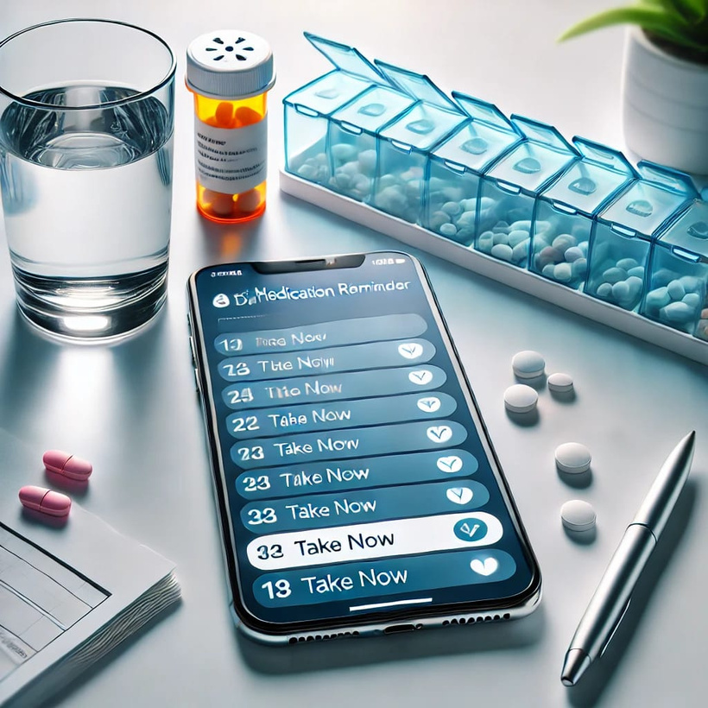
OUR INNOVATIVE SOLUTION:
Disease-Based Medicine Suggestion
Users can enter a disease name.
The app suggests common medicines used for that condition.
A Smart Medication Reminder App that:
Reminds users to take medicine on time.

Slide 4
SMART FEATURES:
Disease-to-Medicine Matching.
Enter a disease, get suggested medicines from a trusted database.
Speeds up setup and helps users with limited medical knowledge.
Custom Medication Schedule
Smart Notifications.
FOR EXAMPLE
Disease: Fever
Suggested Medicine: Paracetamol

Slide 5
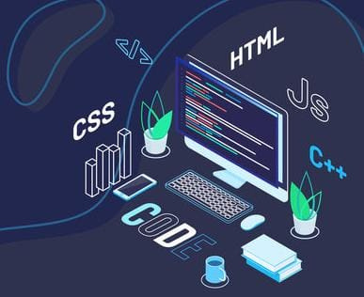
TECH STACK:
FRONTEND: HTML ,CSS,JAVA SCRIPT
BACKEND : PYTHON

Slide 6
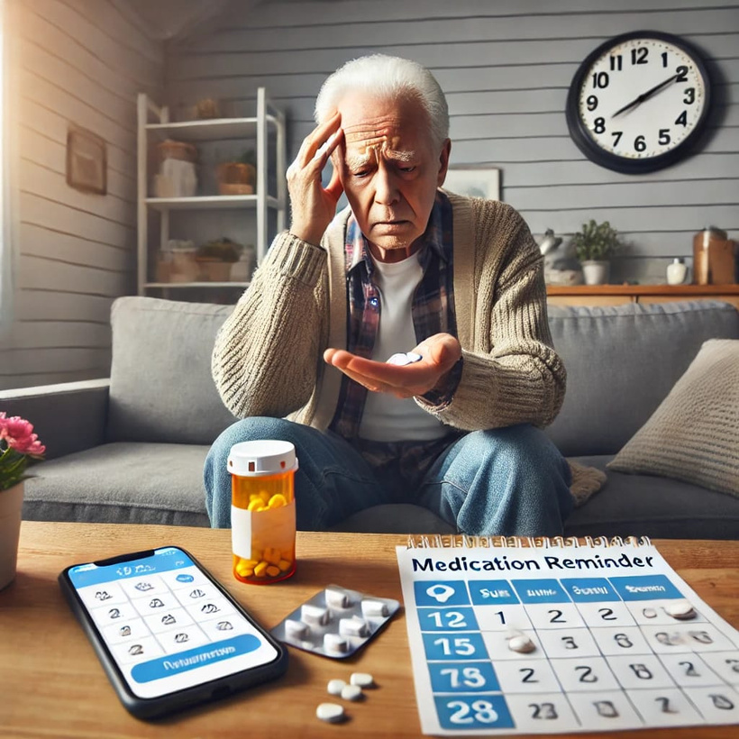
TARGET USERS
1. PEOPLE IN REMOTE/RURAL AREAS
May not have constant access to doctors.
Can benefit from disease-to-medicine suggestions.
2. CAREGIVERS & FAMILY MEMBERS
Want to ensure loved ones are taking their meds.
3. ELDERLY INDIVIDUALS
Often on multiple medications.
May forget doses due to age-related memory loss.
Need a simple, easy-to-use reminder system.
4. BUSY PROFESSIONALS
Miss doses due to hectic schedules.
Need reliable reminders on-the-go.

Slide 7
BENEFITS AND IMPACTS:
Improved medication adherence.
Better health outcomes.
Support for caregivers.
Scalable for clinics or hospitals.
Impact
Boosts medication adherence by up to 90%
Reduces hospital readmissions
Improves patient independence
Eases caregiver responsibilities

Slide 8
CONCLUSION:
Our enhanced Smart Medication Reminder App goes beyond reminders—it acts as
a digital health companion. By allowing users to input their condition and receive
suggested medications .we bridge the gap between symptom awareness and
timely treatment. Combined with personalized schedules, reminders, and caregiver
alerts, this app empowers users to manage their health more proactively. Designed
with accessibility and impact in mind, our solution brings smarter healthcare to
everyone—making it a powerful innovation for both patients and providers.

Slide 9
“HEALTH IS THE REAL WAELTH”
“CARING FOR OTHERS IS THE HEART OF MEDICINE”
THANK YOU

